Slide 1
EE 74099 / EN 74099 Research Project
Project Title: Vision Based Navigation System for Indoor Robots
Progress Presentation – 6
31.05.2019
Under the Supervision of : Dr. WGCW Kumara
And Eng. Abdul Cadar
Team Members:
ANFM. Begum - SEU/IS/13/EG/002
GSU. Ahmadh - SEU/IS/13/EG/011
IIS. Prema Sri - SEU/IS/13/EG/032

Slide 2
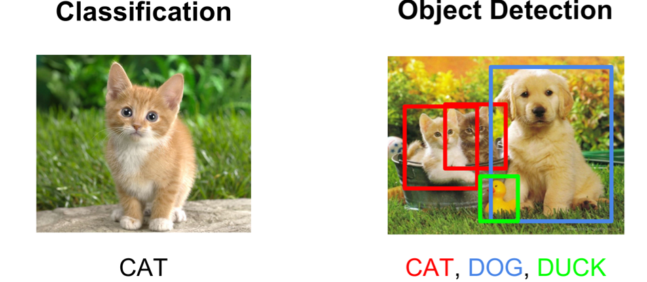
Object detection using deep learning
Predict the object along with the class is called object detection.
From object detection we can predict class and bounding box’s coordinates. Using those coordinates, we can identify the location of object.
Figure 1: Objects with their label and bounding box

Slide 3
To detect the image using classification, below steps will be followed
Train a multi-label classifier
Take windows of fixed sizes from input image
Feed the windows to the image classifier to further process.
There are various object detection methods,
SIFT
HOG features
R-CNN
YOLO
SSD

Slide 4
Object detection with SIFT feature extractor
Stands for Scale Invariant Feature Transform
We can work with single sample image in SIFT.
Steps followed to get object detection
Get features from training image(sample image) and query image(live image from camera)
Match the parameters of both images which are extracted by SIFT(). We can set minimum match count.
If we get good matches, create a border around the object.

Slide 5
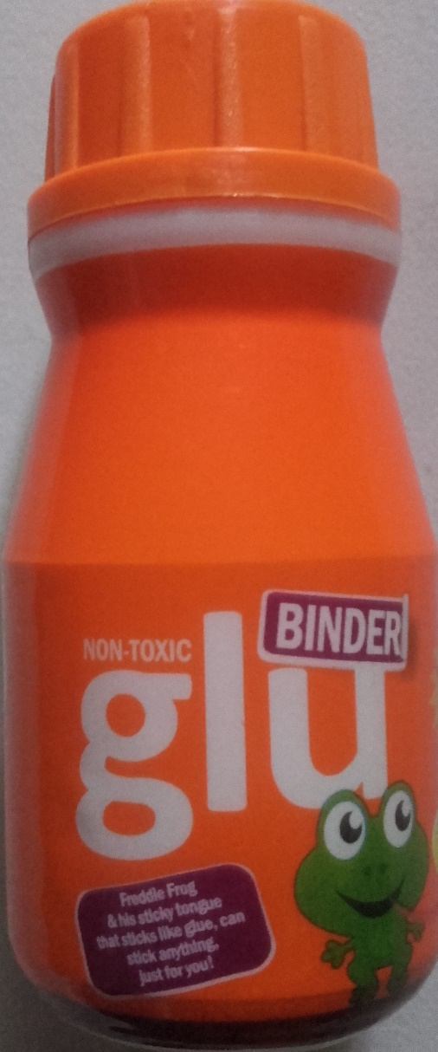
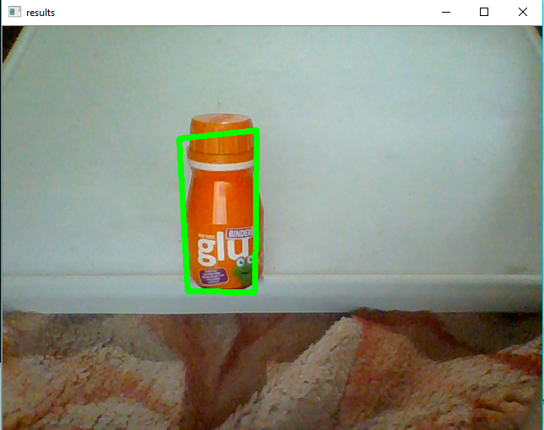
Figure 2: Train Image
Figure 3: Query Image

Slide 6
Video object tracking
We can’t use object detection in each frame when image has multiple objects. Connecting the objects in the frames will be difficult for it.
Also if the object goes out of the camera view, we can’t detect and ensure the same object.

Slide 7
Object tracking process consists four components,
1. Target Initialization
We have to define the starting point of the target by drawing a boundary around it
2. Appearance Modelling
We need to know about material and visual features
3. Motion estimation
Predict the zone where the object will be presented in next frames
4. Target positioning
Use motion estimation’s region to get the exact location of object
Most popular deep learning based approaches
MDNET
GOTURN
ROLO

Slide 8
Currently we are learning and experimenting various methods to be used in detecting and tracking our robot.
Accuracy and robustness of the system is very crucial here as our main navigation system is going to based on this.
We will be updating on the methods we tested and our conclusion about the usage of the system to our purpose in due course.

Slide 9
Thank You

